Slide 1

Cohu Rise Interface
Usability Test Findings
LAPH UX Consulting
Aaron Nathan · Pratik Gami · Helen He · Libby Maurer
Notes:
LIBBY

Slide 2
Section 1 About Cohu
Section 2 Methodology
Section 3 Findings
Section 4 Recommendations
TABLE OF CONTENTS
Notes:
LIBBY

Slide 3
1
About CohuHD Rise
Notes:
LIBBY

Slide 4
ABOUT THE PRODUCT
CohuHD Costar™ is an HD CCTV video surveillance camera system for monitoring border security, transportation, traffic, airports, and railways. The camera system includes the physical camera and a digital interface to view and manipulate footage it captures. The focus of this review is the digital interface.
Notes:
LIBBY

Slide 5
2
Methodology
Notes:
LIBBY

Slide 6
Methodology & Tasks
Format
Participants recruited by CohuHD staff
Remote testing (via Zoom)
User-defined tasks within scenarios
Session Time: 45 mins
Tasks
Change camera zoom & focus
Change camera angle
Add text or image to display
Set up network connection
Troubleshoot network connection
Notes:
LIBBY
Test session format
Background questions
Scenario 1: 4 tasks
Scenario 2: 1 task
Q and A

Slide 7
Severity Rating Scale
3-point Opportunities/Positives
P3
P2
P1
G1
G2
G3
Critical
Moderate
Minor
Good
Very Good
Excellent
Opportunities
Good Stuff
Notes:
LIBBY

Slide 8
Recruiting
Notes:
AARON

Slide 9


Personas
The Distributor
The Strategist
Motivation. Provides specialized surveillance products to government entities.
Behaviors. Talks to vendors, trials new technology, attends vendor-led trainings.
Skills. Understands customer surveillance needs. Recommends solutions that fit budget and use cases. Identifies technical limitations of technology.
Motivation. Makes sure security services personnel have access to video assets 24/7.
Behaviors. Manages strategy for deploying & repairing surveillance technology. Manages visual output from camera.
Skills. Configures network settings. Troubleshoots issues between hardware and firmware. Works with field technicians.
Notes:
AARON

Slide 10
Recruitment Process
1
2
3
Contact Recruiters, ask them to source based on our criteria
Loosen criteria. Source users with similar types of knowledge but not actual Cohu users
Rely on client to recruit from Cohu employees who haven’t used the tool before (not experts)
Fail.
Fail.
Marginal fail.
Notes:
AARON
- We contacted several recruiting firms. They couldn't source participants that met our criteria
- We gave the client an option to source his own or we would find a proxy group (like the Bentley police)
- Client insisted on self-sourcing. We gave very specific criteria
- Client delivered participants with about 7 days to schedule and conduct sessions
- Participants would not meet on weekend (gave us 5 days, not 7)

Slide 11
Participants
Five participants (1 no-show)
All male
All CoStar employees (not users)
45-min sessions
Participant 1 | Participant 2 | Participant 3 | Participant 4
Bench Technician (Novice user) | Technical Support (Expert user) | Technical Support & Testing (Expert user) | Technical Support (Expert user)
Notes:
AARON

Slide 12
3
Findings
Notes:
AARON

Slide 13
Heuristics
We applied these themes (from our Expert Review):
IA: Grouping, Category labeling, & hierarchy
Function labeling
Aesthetics & visibility
Common look & feel
Feedback
Notes:
LIBBY

Slide 14
Task 1
Changing
camera zoom & focus
Task 2
Changing
camera angle
+
Notes:
AARON

Slide 15
Takeaway 1: The PTZ Experience (Tasks 1 & 2)
Finding: Users group tasks 1 and 2 as one experience rather than separate tasks.
Task 1: Change the camera zoom (focus)
Task 2: Change the camera pan (left/right position), tilt (up/down position)
PTZ (Pan, Tilt, Zoom)
Industry term that describes the “chunking” of these tasks.
Users approach these tasks together, suggesting a mental model that should be reflected in the design.
Notes:
AARON

Slide 16
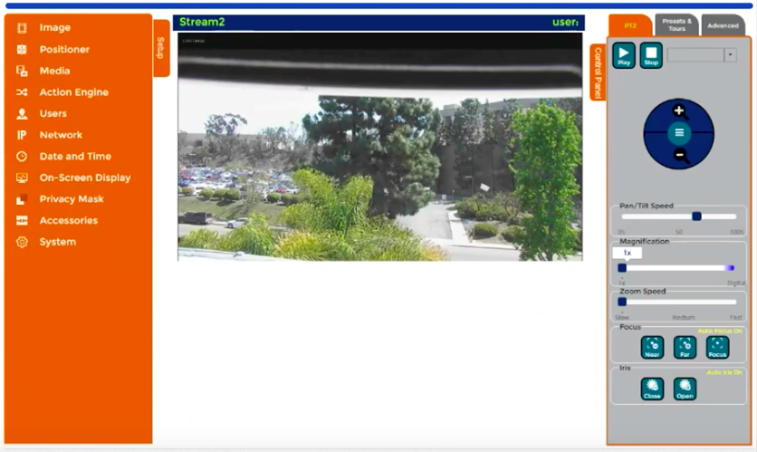
Recommendation: Add hover-over explaining each
Finding: There was confusion when differentiating between magnification and zoom functionality.
Impact on Use: Users pogo-stick (jump back and forth) between the two buttons to use trial and error to determine difference
P2
Severity Rating:
“I don’t know what’s the difference between magnification and zoom. Aren’t they same?” - P1
Notes:
AARON

Slide 17
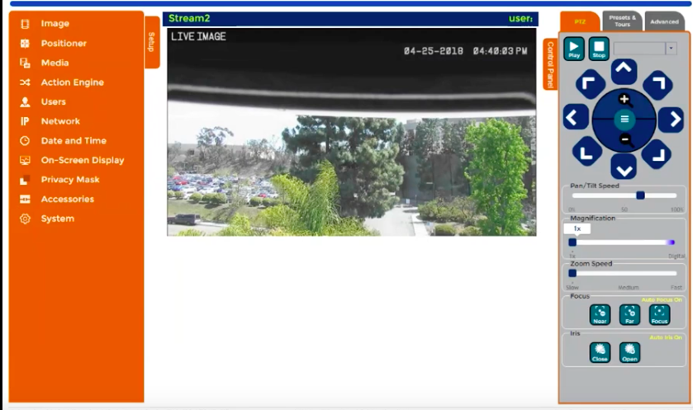
Finding: Camera angle function hidden in hamburger menu, not a conventional use.
Impact on Use: Participants struggled to complete primary task; changing what the camera is looking at.
Recommendations:
Display the functions to change the camera angle upfront and avoid hiding them under the hamburger button.
Use coach marks for first time users to help them discover the on-screen display gestures.
The arrow icon buttons are revealed only after clicking on the hamburger icon.
Severity Rating:
P3
No cues to suggest the drag gesture for controlling the camera angle
“Seems like the camera can only zoom in and out. Can’t really change the angle” - P2
Notes:
AARON

Slide 18
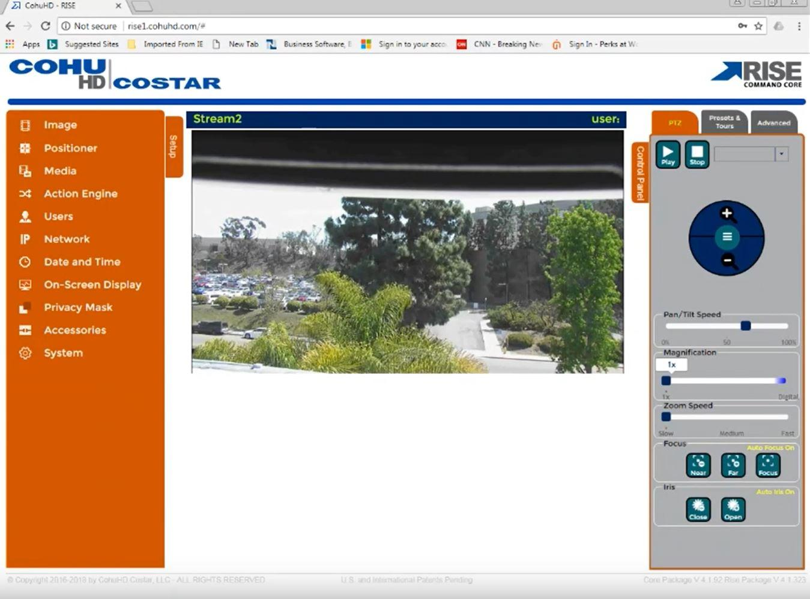
Recommendation: have “live” text display on the screen showing it’s a live shot by default
Finding: No indicator to show if image is live.
Impact on Use: Users unsure whether camera is functioning unless there is motion in image.
Severity Rating:
P2
No cues to suggest the image is a live shot
“I don’t know if it’s a live image or not” - P1
Notes:
AARON

Slide 19
Task 3
Add text or image to broadcast
Notes:
PRATIK

Slide 20
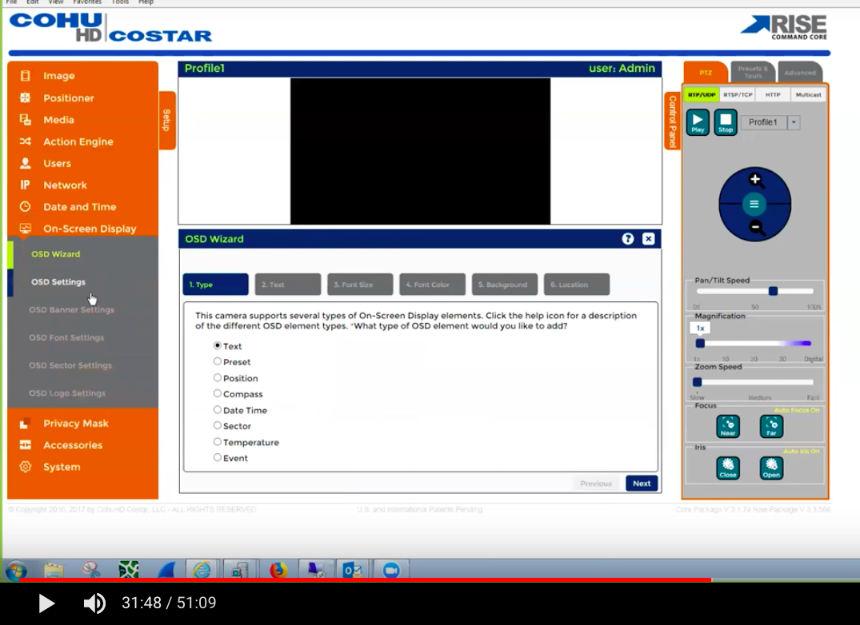
Recommendation: Keep the wizard option
Finding: OSD Wizard is helpful and easy to manipulate.
Impact on Use: Users could quickly find the item to add through the wizard, and everything is clear and easy to understand
Severity Rating:
G3
“Everything is clear in the OSD Wizard, I really like the Wizard” - P3
Notes:
PRATIK

Slide 21
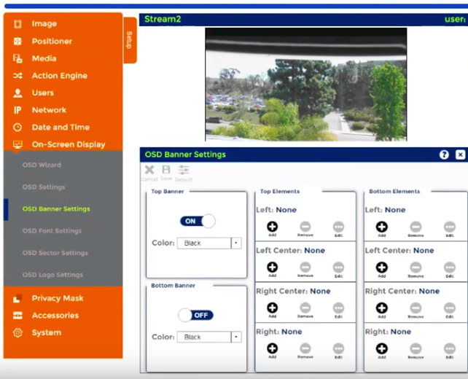
Use of ambiguous labeling like OSD Wizard, OSD Settings, OSD Font Settings, OSD Banner Settings, and OSD Logo settings sets wrong expectations and leads to confusion.
Finding: Labeling of options for secondary level navigation items for On-Screen Display were unclear.
Impact on Use: Users were pogo-sticking (going back and forth between the pages) to find the functions they were looking for.
Severity Rating:
Recommendation: Consider merging the all secondary on-screen display menu options into one single screen
P3
“Seems like it’s pretty flexible on what you can add.” - P3
Notes:
PRATIK

Slide 22
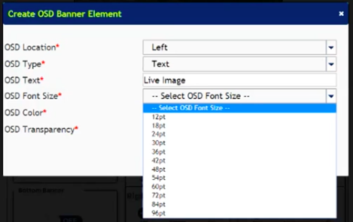
After selecting the font size, users were required to navigate back to the main screen to see the applied changes.
Finding: Users were uncertain about how large font would appear with each option.
Impact on Use: Users used trial and error to determine difference between font sizes and had to pogo-stick between screens to do so.
Severity Rating:
Recommendation: Show preview while adding on-screen display in pop-up to prevent pogo-sticking.
P3
“I want it to be real big, so… I’m gonna assume 12pt is smallest in the scale.” - P1
Notes:
PRATIK

Slide 23
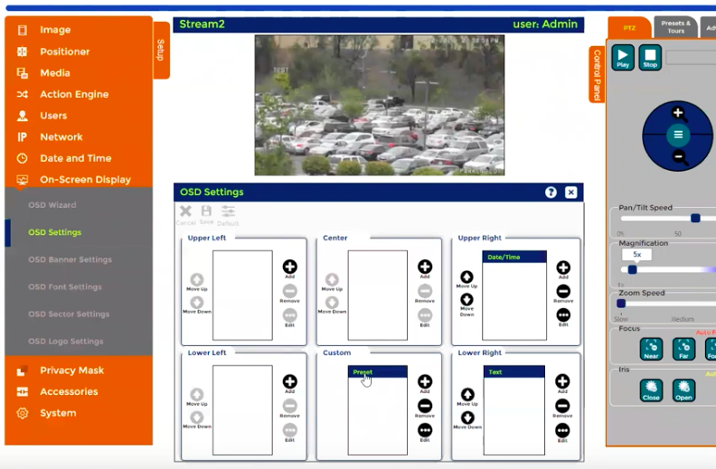
The highlight here is used to show active selection. However, multiple highlights leads to confusion. Also, any action on one item leads to selection of other items adding to the confusion, compounding the effects
Findings: Users were confused about how to use these controls to add and/or edit text to the image.
Impact on Use: Users became frustrated on this page and abandoned the page as a means to edit text.
Severity Rating:
Recommendation: Avoid unconventional use of web controls.
P3
“I don’t know what the highlight means. Once you hit remove, it unhighlights the other options.” - P4
Notes:
PRATIK

Slide 24
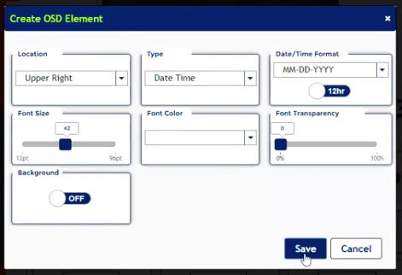
Findings: Participants were confused why the save button was not working when they had edited the text options.
Impact on Use: After repeatedly clicking on the ‘Save’ button participants abandoned this means of adding text unless provided with an assist.
Severity Rating:
Recommendation: Consider providing feedback message like ‘Saved successfully’, ‘All the fields are mandatory’ or something similar after clicking on save.
P3
No feedback after repeatedly clicking on ‘Save’ button
“Save, save, save, save.” - P3
Notes:
PRATIK

Slide 25

User expected to move the text by simply clicking and dragging it.
Finding: Participants disappointed when they tried to click and drag text on the image to move it and the text did not move.
Impact on Use: This forced users to try to find a convention that was less natural to them.
Severity Rating:
Recommendation: Enable user to move the text position by click and drag on the image.
P1
“Not able to move text position by clicking and dragging it.“ - P2
Notes:
PRATIK

Slide 26
Task 4
Setting up network connection
Notes:
HELEN

Slide 27
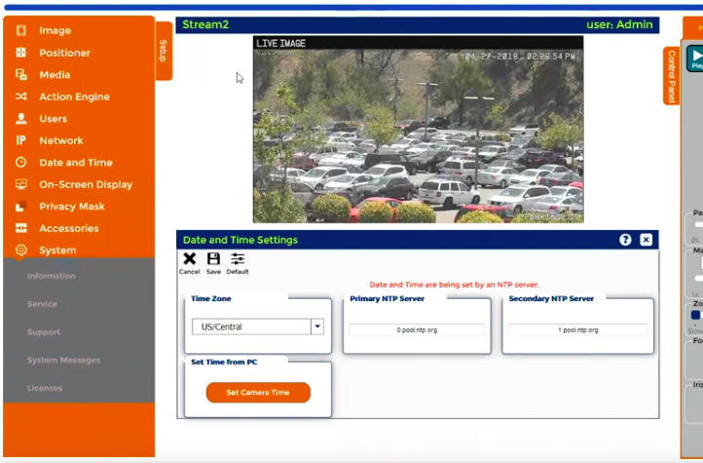
Findings: Participants went to “System” first to change network settings.
Impact on Use: Participants not able to find network settings on the first attempt, causing moderate frustration.
Severity Rating:
Recommendation: Consider relabeling the ‘System’ menu option as users might get confused between ‘Systems’ and ‘Network’
P2
Users expected the network settings to be part of ‘System’ menu item and thus clicked on it initially.
(after exploring for while)
”Mmm...I’d go to Network>Network Settings.” - P3
Notes:
HELEN

Slide 28
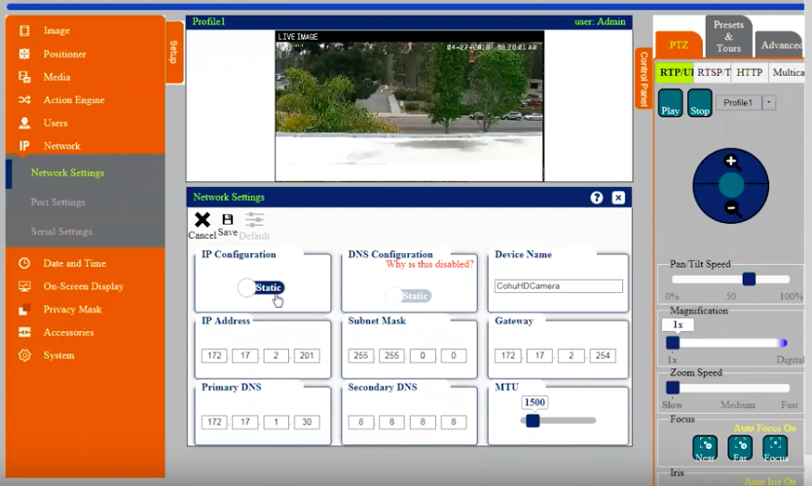
Recommendation: Keep network setting options as currently displayed.
Findings: Once participants got into the Network Settings, they could easily modify the settings for their needs.
Impact on use: Users could efficiently and pleasantly set up the Network.
Severity Rating:
G2
Options inside ‘Network Settings’ were quite intuitive.
Notes:
HELEN

Slide 29
Task 5
Checking & troubleshooting
network connection
Notes:
HELEN

Slide 30
Recommendation: Keep network setting options as currently displayed.
Findings: Participant could check and troubleshoot the network connection successfully.
Impact on Use: Since this is the primary task on the software after initial setup, the ease of use of this section provides delight in an otherwise challenging context - troubleshooting.
Severity Rating:
G3
Participants were able to quickly find and modify IP settings.
Notes:
HELEN

Slide 31
4
Recommendations
Notes:
LIBBY

Slide 32
Summary of Findings
Good stuff
Upfront zoom and focus options are clear
System auto-adjusts camera speed upon zooming in
Adding on-screen display elements is straightforward
Network settings are understandable
Use of industry-accepted terminology and abbreviations
Notes:
LIBBY

Slide 33
Summary of Findings
High-Impact Opportunities
Lack of clarity in Information Architecture
Hidden camera functions and gestures
Unclear labels of menu items
Poor feedback on click of ‘Save’ button
Absence of preview while adding/editing on-screen display elements
Small-Impact Opportunities
Unconventional use of web controls
Notes:
LIBBY

Slide 34
Summary of Recommendations
Do these things NOW for big impact:
Prominently display the functions for changing camera angle; avoid hiding them under the hamburger button.
Use coach marks for first time users to help them discover the on-screen display gestures.
Show preview while adding on-screen display in pop-up to prevent pogo-sticking.
Consider providing feedback upon saving changes/updates.
Consider relabeling the “Systems” menu option to clarify the actions in “Systems” vs “Network”
Avoid unconventional use of web controls
Notes:
LIBBY

Slide 35
Summary of Recommendations
Explore these improvements LATER with more research:
Consider merging all secondary on-screen display menu options into a single screen
Consider revisiting configuration of information architecture scheme for entire interface
Notes:
LIBBY

Slide 36
Next Steps
We recommend these actions to prioritize our findings:
Follow-up study with users who fit persona criteria
5-8 participants
Strategizers & Distributors
Repeat Tasks 1-5
Compare findings to ours
Conduct card sort exercise for IA direction
5-8 participants
Strategizers & Distributors
Compare findings to ours
Notes:
LIBBY
Perform a follow-up study with users that fit the persona criteria
5-8 participants
Even number of Strategizers and Distributors
Repeat Tasks 1-5

Slide 37
Thank you.
LAPH UX Consulting
Notes:
LIBBY

